Slide 1
Recipe redux
By: Devin Rayfield
Advisor: Mitchell Neilsen

Slide 2
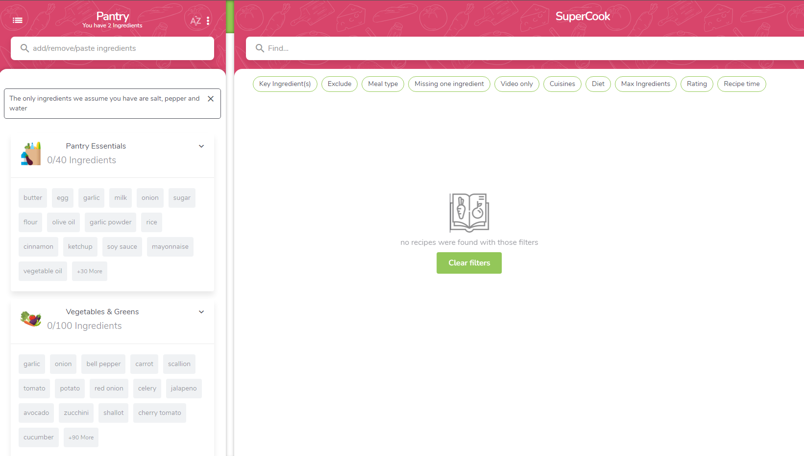
NEW PROJECT?!?!!!!!!
What is it?
Why this project?
Inspiration:
Supercook

Slide 3
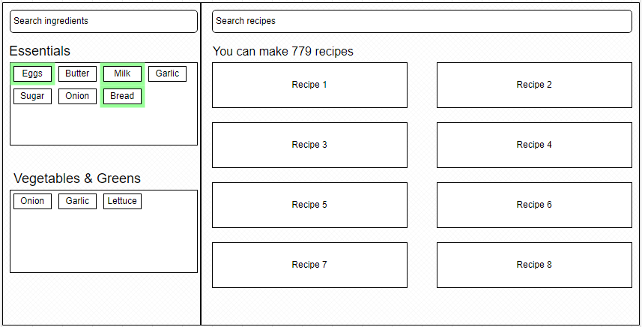
UI Design
Notes:
This is a very basic UI mockup of what the app looks like. The ingredients are on the left and the recipes that match those ingredients are on the right. There’s more than just this which you’ll see in a second. Now, I’m gonna go very quickly over a few of the key things from presentation 1, since this is a new project.

Slide 4
MVP
Ingredient Selection
Pantry
Basic Recipe Display

Slide 5
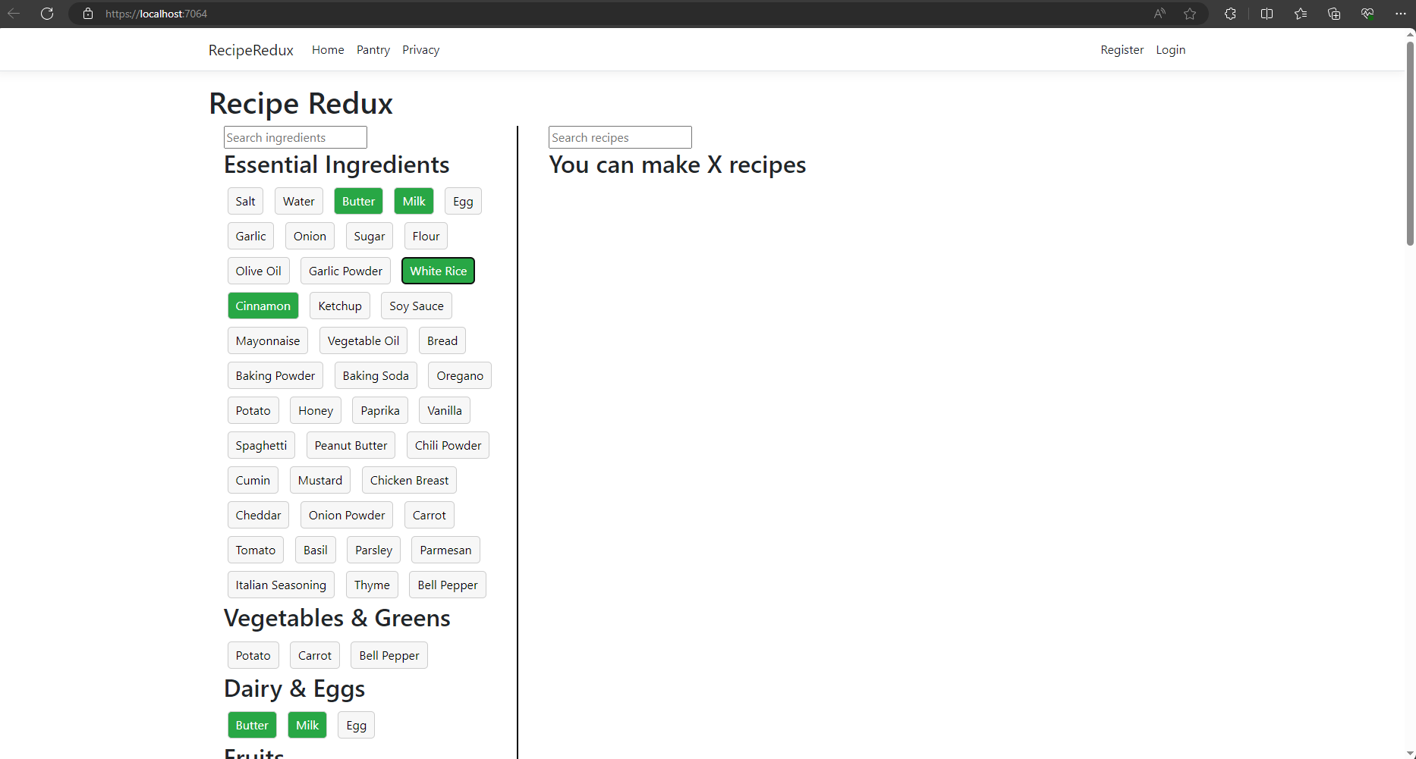
Notes:
Some ingredients overlap like butter is an essential ingredient and it’s also in dairy. At the top of the nav bar is the pantry which you click on and it shows the ingredients you selected. The only thing that doesn’t fully work right now is displaying the recipes. I ran into a little snag getting those to work with the API which I’m using an API from Edamam, but that shouldn’t be that hard. That’s what I’m currently working on.

Slide 6
Versions 1.0 / 2.0
User Authentication
Recipe Filtering
Grocery List
Interactive Pantry
User Profile Management
Export Recipes
Social Sharing
Notes:
Now onto my diagrams…

Slide 7
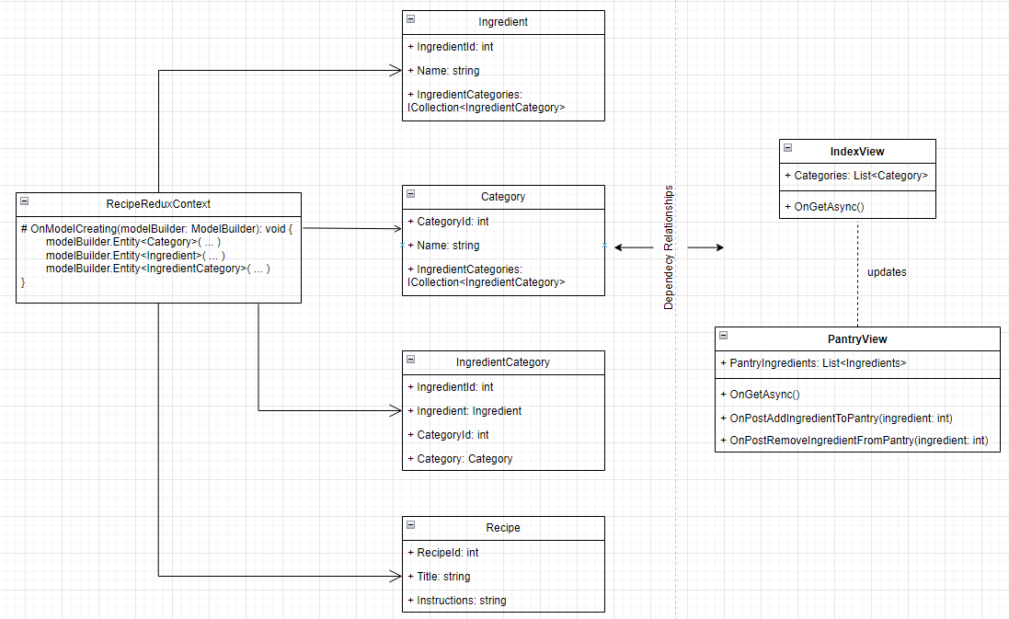
UML
Notes:
This is a vey basic version of my UML diagram. It’s missing a few classes and functions and things that I have yet to implement but these are the most important things involved in the logic. Note the RecipeReduxContext which is the database that I’ve manually populated for now.

Slide 8
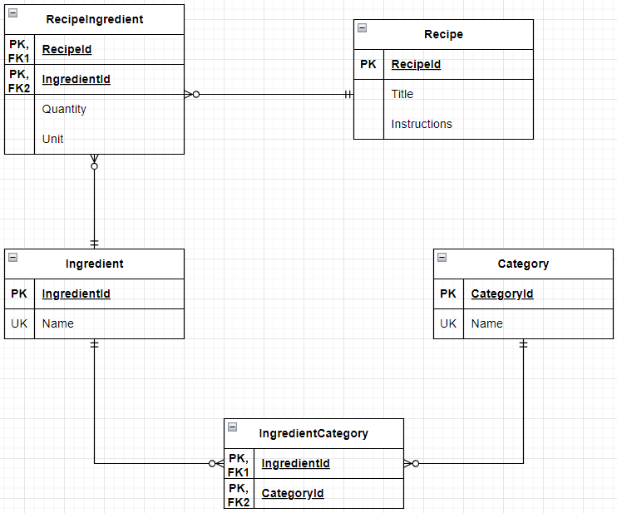
Database
Notes:
Broken up into junction tables

Slide 9
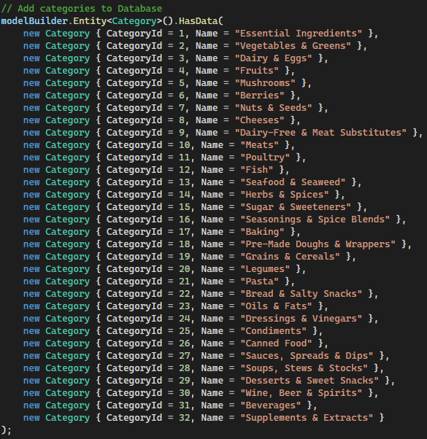
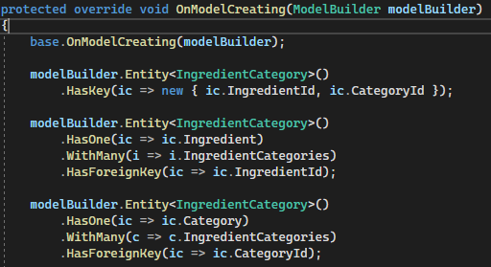

Slide 10
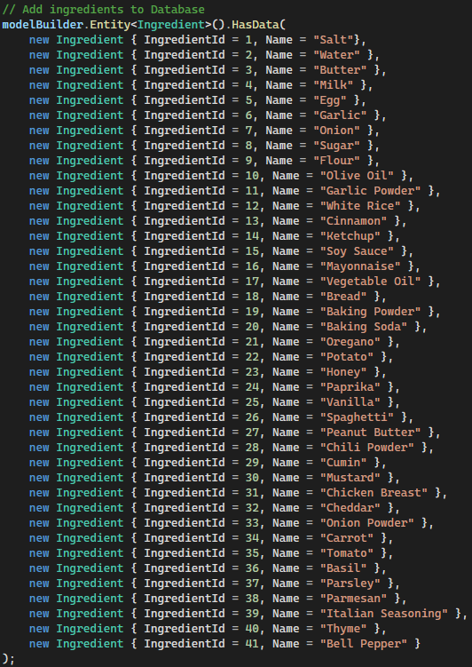
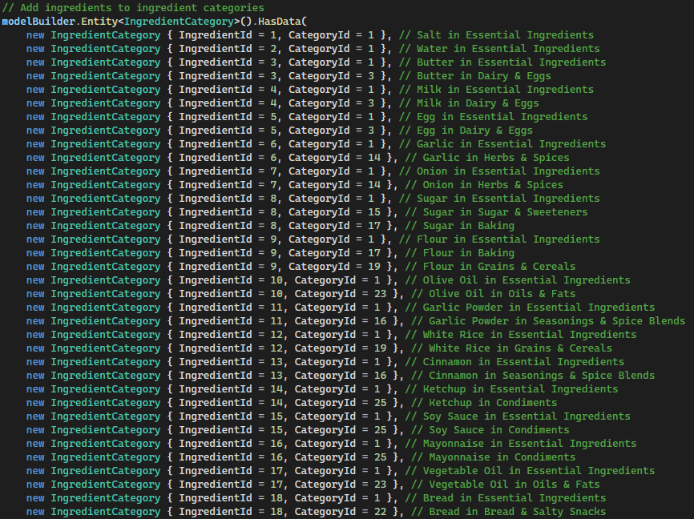

Slide 11
Testing
Manual
Use cases:
Create account
Display correct recipes
Update pantry correctly
Unit Testing
Notes:
I didn’t include any sitemaps or sequence diagrams because I think the flow is fairly self explanatory and most of the logic and user interaction happens on the home page the only time you leave is for registering an account/logging in or viewing your pantry and grocery list.

Slide 12
Timeline
March 25:
Decided New Topic
April 16:
MVP Complete
April 30:
V1.0 Finished
March 27-29:
Resubmit Design Documents/
First Presentation
April 17:
Second Presentation
Finals Week:
Final Presentation/Get as much of
v2.0 done as possible
Notes:
Decided on new topic idea March 25. Quickly redid my initial design documents and first presentation. MVP got pushed back a little bit due to exam week and other programming projects I had due in other classes. I can finish my MVP in about a day’s more work and the rest of the project should be on track as shown.

Slide 13
What’s left
Finish Displaying Recipes
Add User Authentication
Recipe Filtering (this will take most of the rest of my time)
Grocery List
Styling

Slide 14
Questions?

